Slide 1

BASIC JAVA CLASS-7
Instructor
SALMAN RAHMAN
ROAD TO SDET

Slide 2
CONTENTS
Class/Method/Object/Properties
Constructor
Inheritance
Polymorphism
Encapsulation
Abstraction
Interface

Slide 3
DEFAULT CONSTRUCTOR
public class DefaultConstructor { public DefaultConstructor(){ System.out.println("Calling default constructor"); } public static void main(String[] args) { DefaultConstructor defaultConstructor=new DefaultConstructor(); } }

Slide 4
PARAMETERIZED CONSTRUCTOR
public class ProductSell { public int vat; public ProductSell(int vat){ this.vat=vat; } public int getPrice(int price){ price+=(price*vat/100); return price; } public static void main(String[] args) { ProductSell shirt=new ProductSell(15); int totalPrice= shirt.getPrice(100); System.out.println(totalPrice); } }

Slide 5
Static Keyword
public class ProductSell { public static int vat = 15; public int getPrice(int price){ price+=(price*vat/100); return price; } public static void main(String[] args) { ProductSell shirt=new ProductSell(); int totalPrice= shirt.getPrice(100); System.out.println(totalPrice); System.out.println( ProductSell.vat ) } }

Slide 6
INHERITANCE
public class MyInheritance { public static void main(String[] args) { Fish animal=new Fish(); animal.talk(); animal.breeds("fish"); } } class Animal{ public void talk(){ System.out.println("Animals can't talk"); } public void breeds(String animal){ System.out.println(animal+" gives birth "+animal); } } class Fish extends Animal{ }

Slide 7
Super Keyword
Used To call parent class property / method
public class MyInheritance { public static void main(String[] args) { Fish fish=new Fish(); fish.check(); } } class Animal{ public void talk(){ System.out.println("Animals can't talk"); } } class Fish extends Animal{
public void talk(){
System.out.println(“Fish can't talk"); }
public void check(){
//talk();
super.talk();
} }

Slide 8
POLYMORPHISM
public class MyPolymorphism { public static void main(String[] args) { Birds birds=new Birds(); birds.talk(); Birds parrot= new Parrot(); parrot.talk(); } } class Birds{ public void talk(){ System.out.println("Birds can't talk"); } } class Parrot extends Birds{ public void talk(){ System.out.println("Parrot can talk"); } }

Slide 9
OVERLOADING
public class MyOverloading { public static void main(String[] args) { Salary salary=new Salary(); int mySalary= salary.mySalary(5,2); System.out.println(mySalary); } } class Salary{ public int mySalary(int hour){ return hour*500; } public int mySalary(int hour, int overtime){ return (hour*500)+(overtime*1000); } }

Slide 10
ENCAPSULATION
//Encapsulation
class Dress{ private String brand; private String color; private String size; public String getBrand() { return brand; } public void setBrand(String brand) { this.brand = brand; } public String getColor() { return color; } public void setColor(String color) { this.color = color; } public String getSize() { return size; } public void setSize(String size) { this.size = size; } public int getPrice(int price,int discount){ return price=price-(price*discount/100); } }
public static void main(String[] args) { Tshirt tshirt=new Tshirt(); tshirt.setBrand("Aarong"); tshirt.setColor("Blue"); tshirt.setSize("XL"); System.out.println(tshirt.getBrand()); System.out.println(tshirt.getColor()); System.out.println( tshirt.getSize()); System.out.println(tshirt.getPrice(500,25)); }

Slide 11
ABSTRACT CLASS
public class MyFood { public static void main(String[] args) { Food biriani=new Biriani(); biriani.cookFood(); Food khichuri=new Khichuri(); khichuri.cookFood(); Food food=new Food() { @Override void cookFood() { System.out.println("Cooking food"); } }; food.cookFood(); } } abstract class Food{ abstract void cookFood(); } class Biriani extends Food{ void cookFood(){ System.out.println("Cooking biriani"); } } class Khichuri extends Food{ void cookFood(){ System.out.println("Cooking khichuri"); } }

Slide 12
INTERFACE
public interface MyInterface { void drawShape(); } class Rectangle implements MyInterface{ public void drawShape(){ System.out.println("Drawing rectangle"); } } class Circle implements MyInterface{ public void drawShape(){ System.out.println("Drawing circle"); } } class TestInterface{ public static void main(String[] args) { MyInterface rectangle=new Rectangle(); rectangle.drawShape(); MyInterface circle=new Circle(); circle.drawShape(); } }

Slide 13
MULTIPLE INHERITANCE USING INTERFACE
public class MultpleInterface { public static void main(String[] args) { Child child=new Child(); child.looksLike(); child.behaviour(); } } interface Father{ void looksLike(); } interface Mother{ void behaviour(); } class Child implements Father,Mother{ public void looksLike(){ System.out.println("Looking like father"); } public void behaviour(){ System.out.println("Behave like mother"); } }

Slide 14
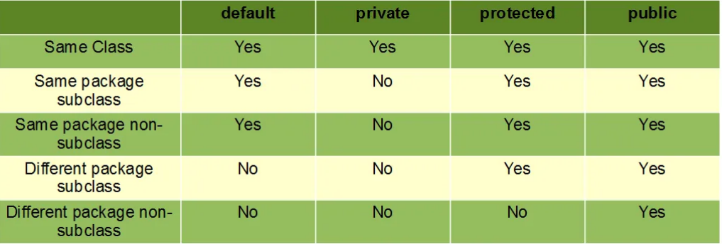
Access Modifier

